Slide 1
> R You Ready?
INTRODUCTION TO R

Slide 2


Slide 3
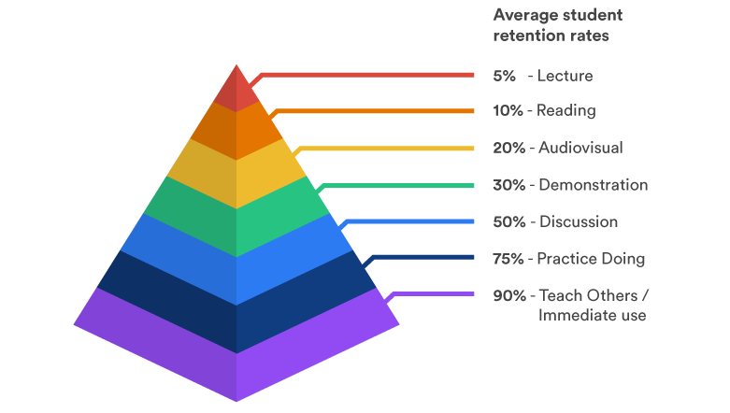
Learning Pyramid

Slide 4
WHILE WE TEACH, WE LEARN.
SENECA

Slide 5
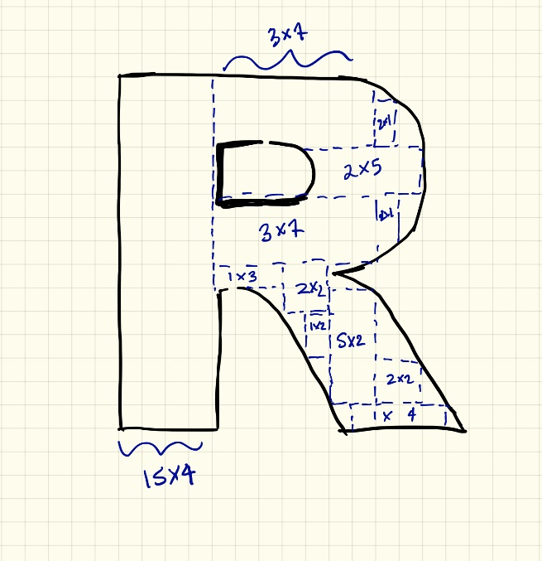
What is R?
A freely available language and environment for statistical computing and graphics which provides a wide variety of statistical and graphical techniques
https://www.r-project.org/

Slide 6
Developed by Ross Ihaka and Robert Gentleman at University of Auckland
First appeared Aug 1993; 25 years ago
• Some capabilities of R include:
> Software development
> Data analysis and visualization
> Text processing
> Image processing
> Interact with APIs
> Building interactive web apps
> Writing project report or book
> Creating presentations

Slide 7
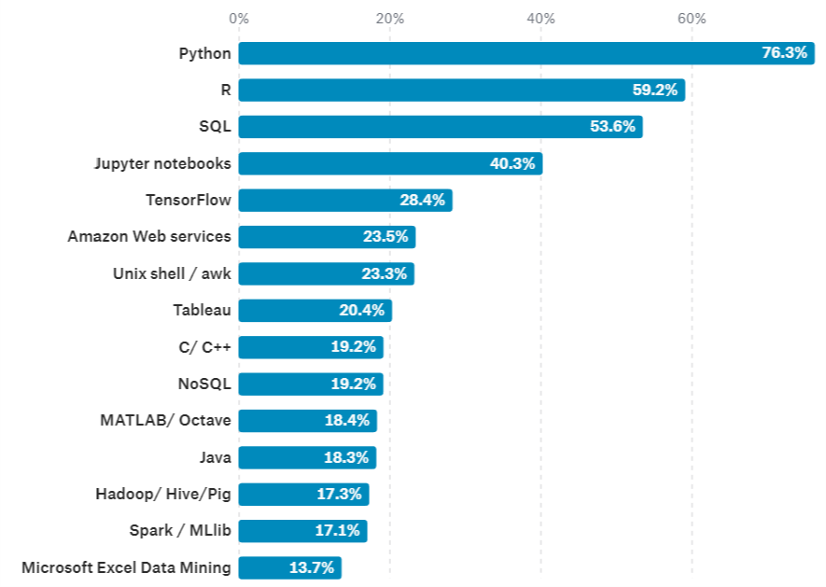
What tools are used at work?
Kaggle's The State of Data Science 2017
https://www.kaggle.com/surveys/2017

Slide 8
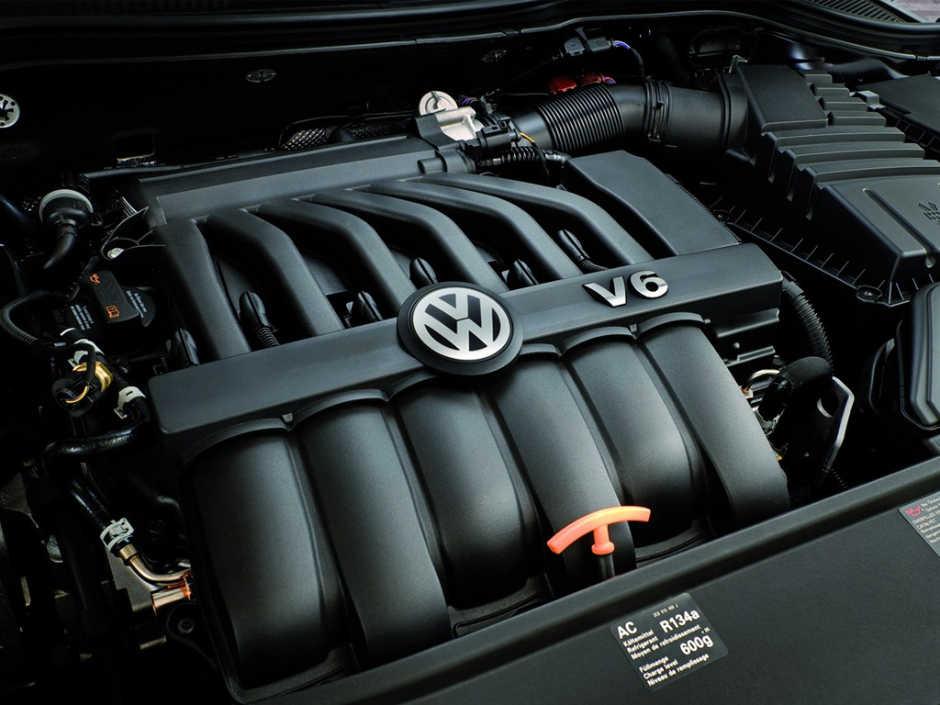
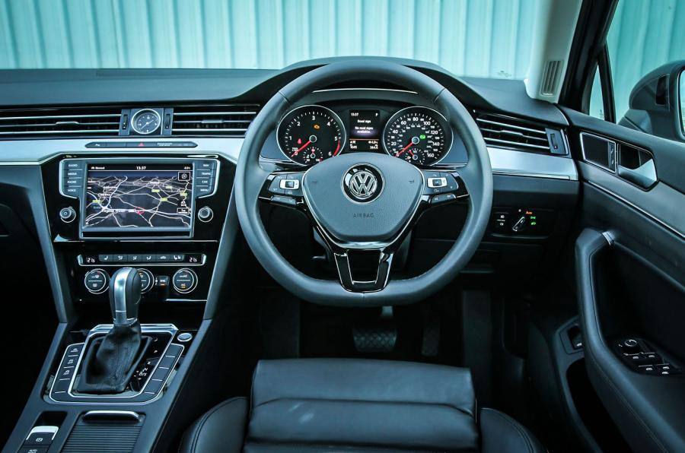
What are R and RStudio?
R: Engine
RStudio: Dashboard

Slide 9


Using R via RStudio
R: Do not open this
RStudio: Open this

Slide 10



What are R packages?
R: A new phone
R Packages: Apps you can download

Slide 11
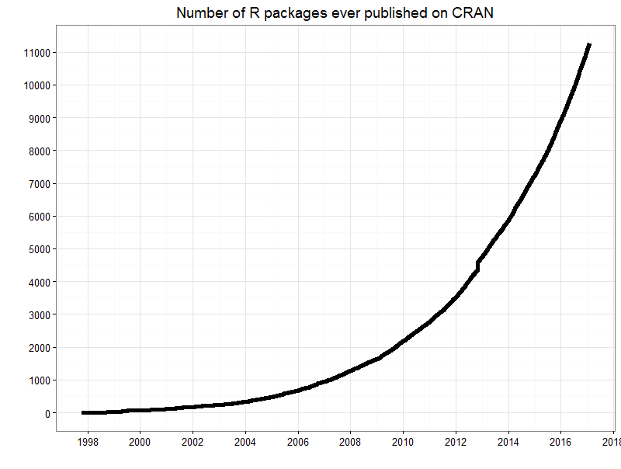
Currently, the CRAN package repository features 13529 available packages: https://cran.r-project.org/web/packages/

Slide 12
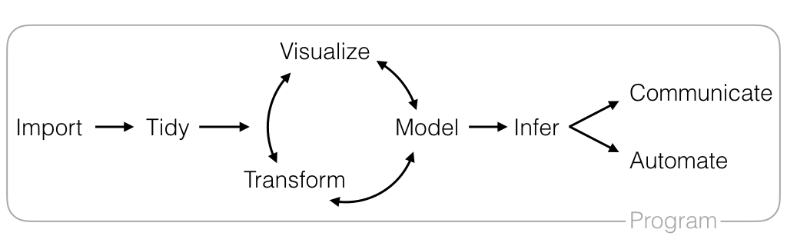
Data Science Workflow

Slide 13
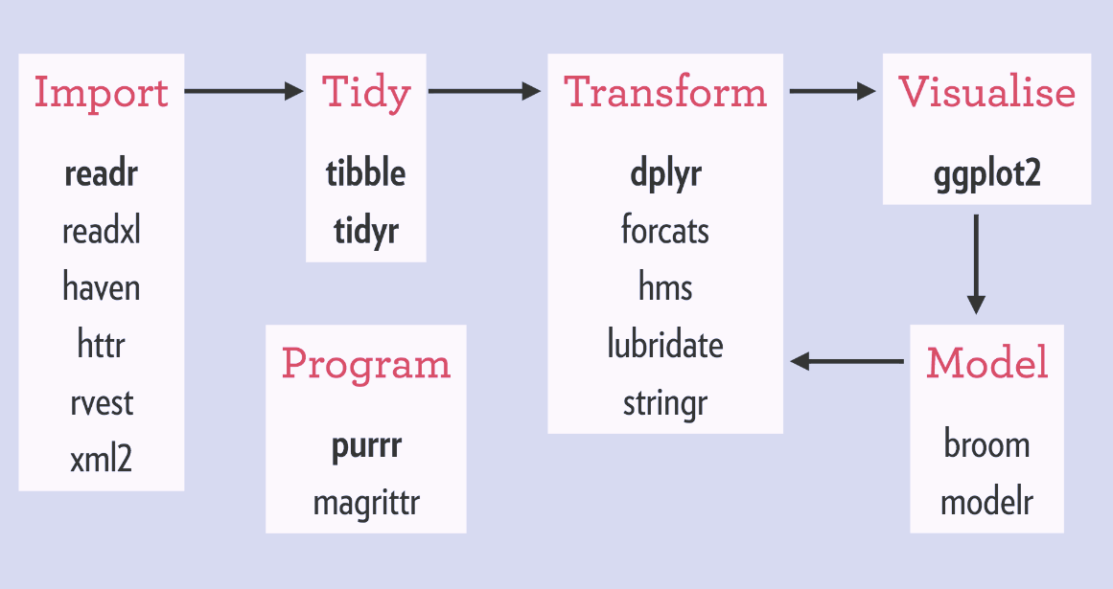

Slide 14
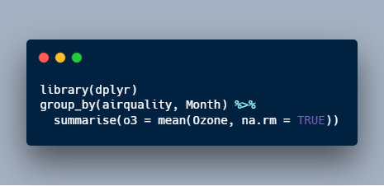
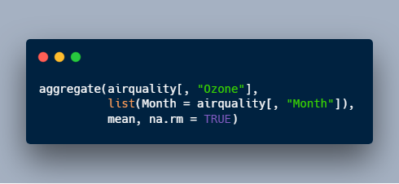
To take the mean within groups of a variable in a data frame
Self-explanatory
Easier to understand
What are the square brackets [ ] for?
What is list()?
Why is the mean() function just sitting there all by itself?
Is na.rm = TRUE an argument to aggregate()?

Slide 15
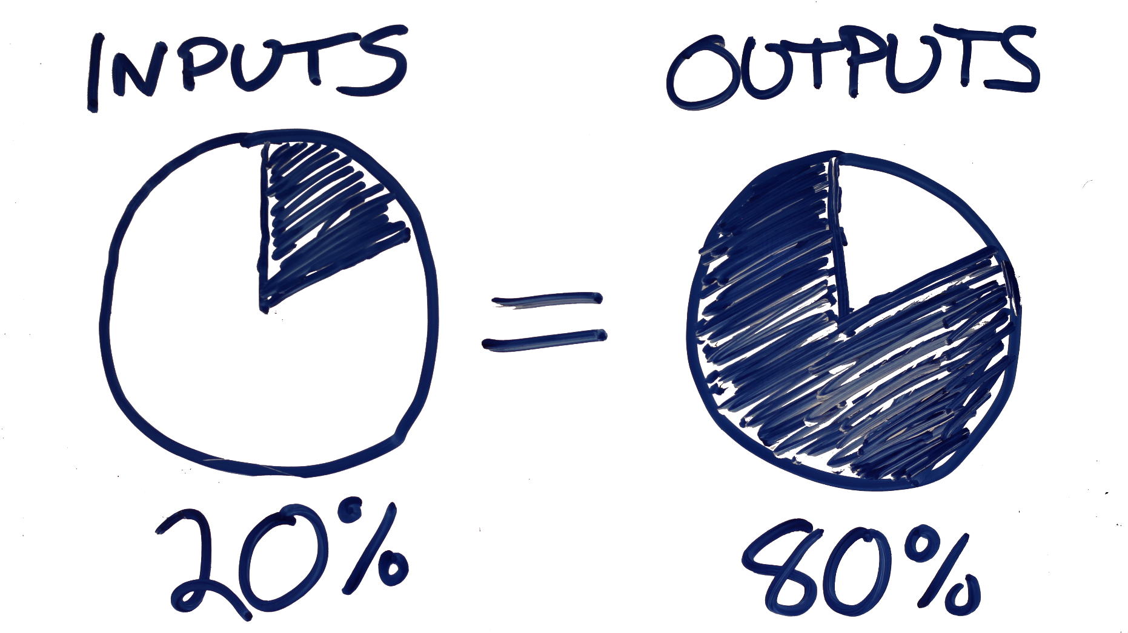
Pareto Principle

Slide 16
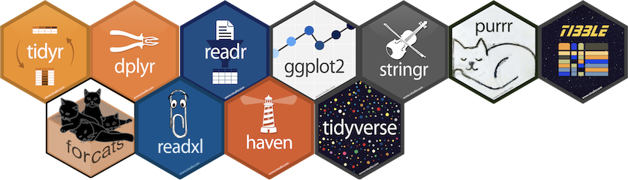
Tidyverse
Collection of R packages designed to work together.
All packages share an underlying design philosophy, grammar, and data structures.
An easier way to code!

Slide 17
dplyr: Grammar of data manipulation
ggplot2: System for declaratively creating graphics, based on The Grammar of Graphics
tibble: Modern reimagining of the data.frame, keeping what time has proven to be effective, and throwing out what is not
readr: Fast and friendly way to read rectangular data (like csv, tsv, and fwf)
tidyr: Tools to help you create tidy data where each variable is in a column, each observation is a row, and rach value is a cell
purrr: Functional programming toolkit
Learn more at tidyverse.org/

Slide 18
Basic Data Types in R
Data Type | Stores
character | strings
numeric | integers or double
integer | integers
complex | Complex numbers
logical | TRUE or FALSE

Slide 19
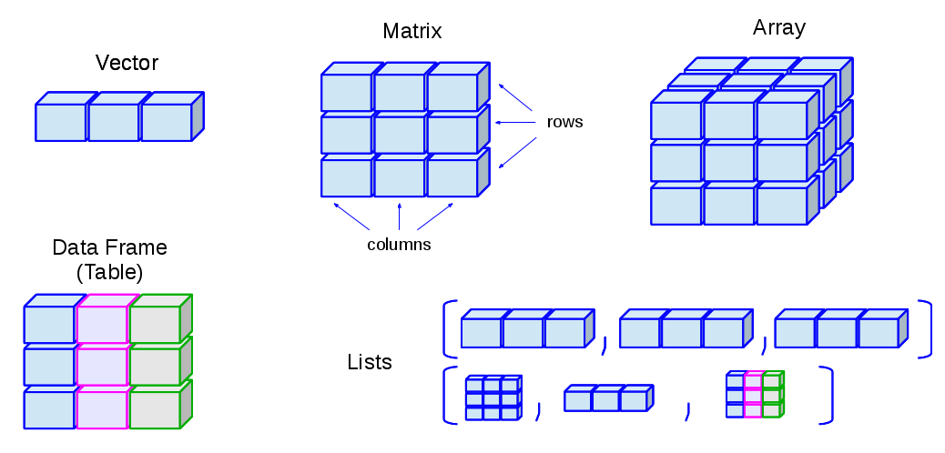
Data Structures in R

Slide 20

Tidy Data
Variables must be in columns
Observations must be in rows
Values must be in cells

Slide 21

What is dplyr?

Slide 22
Grammar of data manipulation
+ mutate() to create new variables from existing ones
+ select() picks variables on their names
+ filter() allows pointed selection based on given criteria
+ summarise() reduces multiple values down to a single summary
+ arrange() changes the ordering of rows
+ group_by() performs any of the above on a group-by-group basis

Slide 23
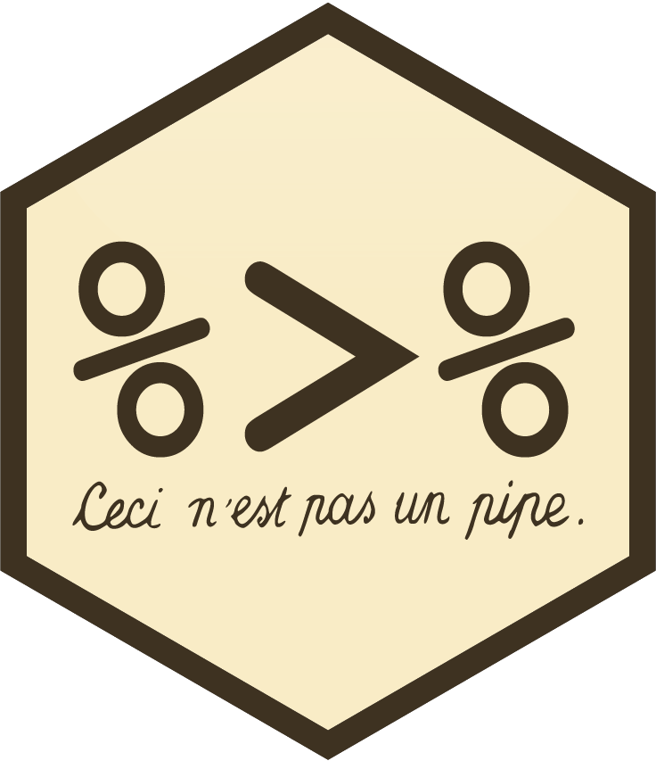
dplyr syntax:
All calls to dplyr verbs follow the same format:
The first argument is a dataframe.
The subsequent arguments describe what to do to that dataframe using unquoted variable names.
Each call returns a new dataframe rather than overwriting the old one.
%>% allows you to pipe the output from one function to the input of another function to reduce redundancy.
Instead of nesting functions (reading from the inside to the outside), the idea of of piping is to read the functions from left to right.

Slide 24
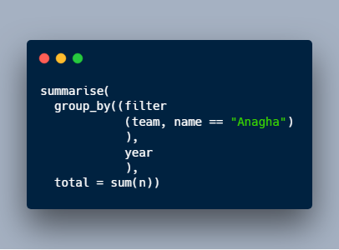
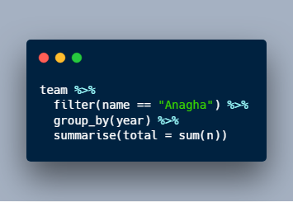
%>%
Before
After

Slide 25

How do I code in R?

Slide 26


Slide 27
Further Resources
Introduction to R - https://www.datacamp.com/courses/free-introduction-to-r
Introduction to the Tidyverse - https://www.datacamp.com/courses/introduction-to-the-tidyverse
R Programming A-Z™ - https://www.udemy.com/r-programming/
R for Data Science - Garrett Grolemund & Hadley Wickham - https://r4ds.had.co.nz/
Cheat Sheets - https://www.rstudio.com/resources/cheatsheets/

Slide 28
THANK YOU

